Slide 1

All for one one for All
Author: Bamshad Shirmohammadi
Supervisor: Professor Arend Hintze
Genetic algorithm using different objective functions training virtual artificial intelligent agents, performed data analysis, tested which objective function optimizes individual and cooperative behavior the best.

Slide 2

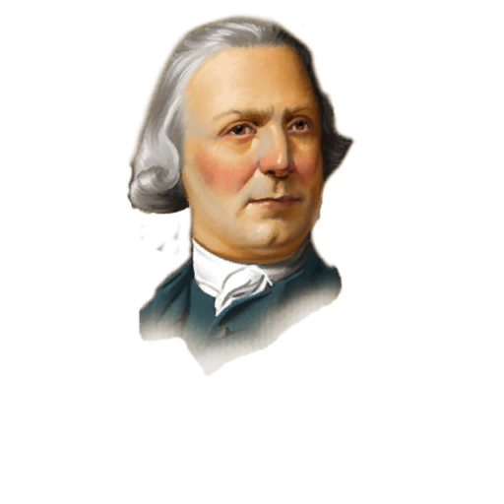
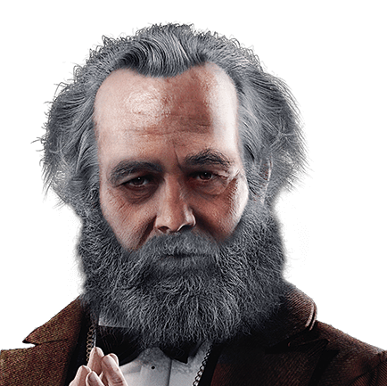
Introduction
Imagine a school which all the students help the weakest one!
It is a Beautiful dream!
By the way, I am going to establish one of the best schools in the real world!
Can we find a common ground?
WE

Slide 3
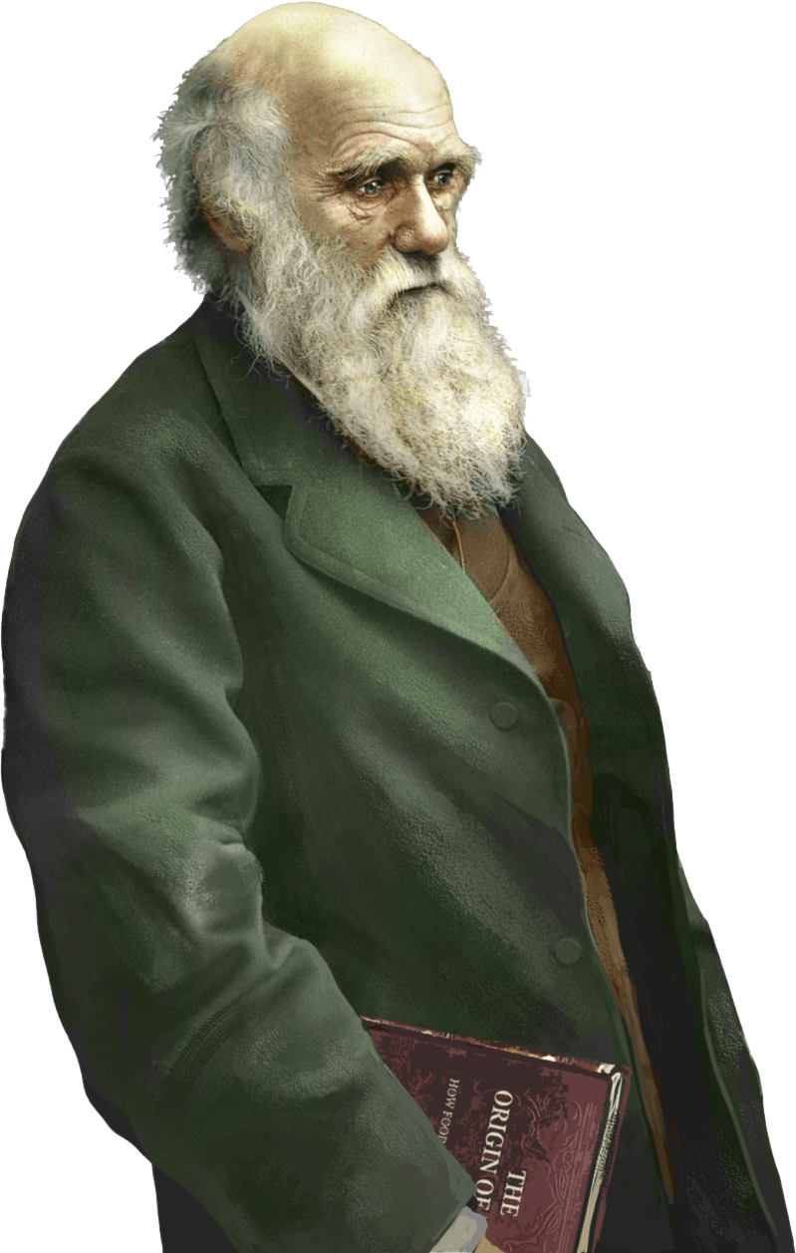
Evolvable artificial robots? I am confused!
Introduction
Yes, it is a big goal in the world of humans but, we are going to do it in world of Artificial Intelligence
We will train a group of AI controllers (agents) to perform better individually and in teams at the same time.
By train we mean evolving the agents so their last generation is “optimal”.

Slide 4
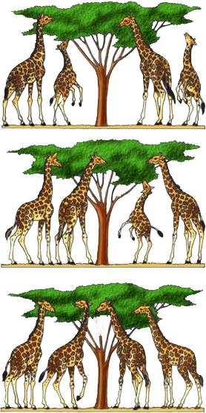
Inheritance, variation, Natural selection,
Create a population of random agents
Test the performance of each agent. Agents that perform better have a higher chance to produce offspring (selection).
Evolution
Genetic algorithm
Create the population of the new generation (Inheritance),
Apply mutations to agents in the new generation (variation)
Repeat the previous three steps.

Slide 5
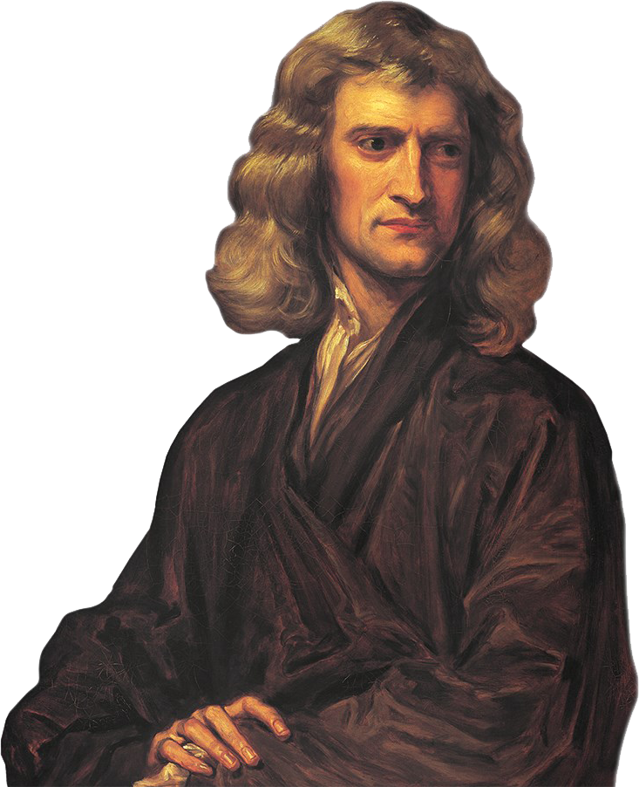
"If I have seen further it is by standing on the shoulders of Giants.”
Methodology
MABE creates and manages populations of evolving digital organisms which are evaluated in worlds. Using the results of the evaluations new populations are generated by means of natural, artificial, and/or sexual selection.

Slide 6

World
Agents that can move around sense the environment, communicate, pickup grass, and give grass to other agents.
How do we evaluate performance?

Slide 7
Selection by objective function
Individual
Clone
10
20
30
40
Average
25
25
25
25
10
20
30
40
Minimum
Not Clone
10
10
10
10
Maximum
40
40
40
40

Slide 8
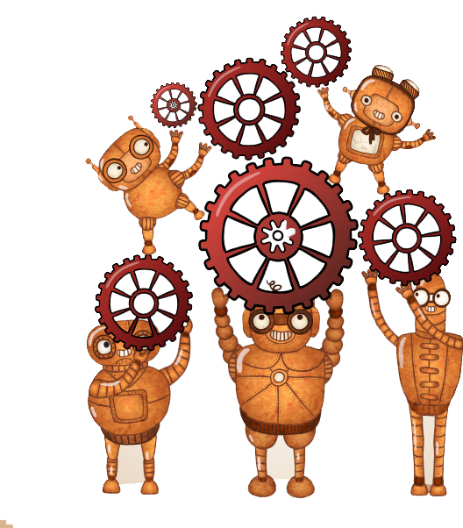
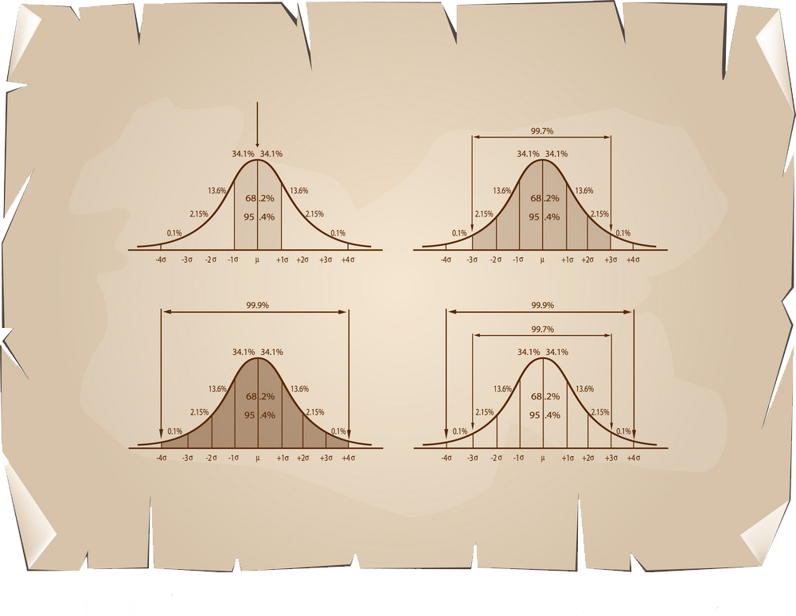



MABE
Methodology
Three different types of CSV files per experiment per replicate (2400 files)
Generation id score
1 14
. . .
. . .
. . .
5000 20000 40
python codes

Slide 9
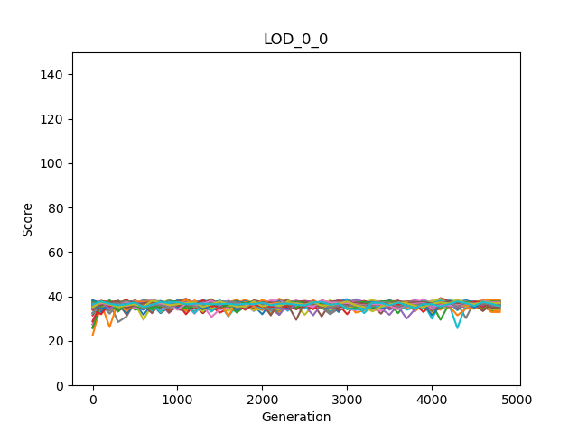
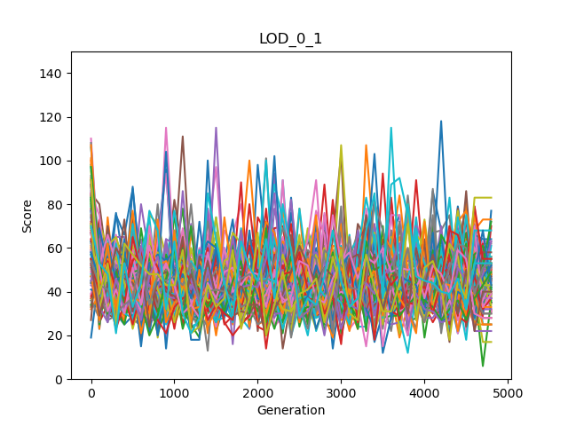
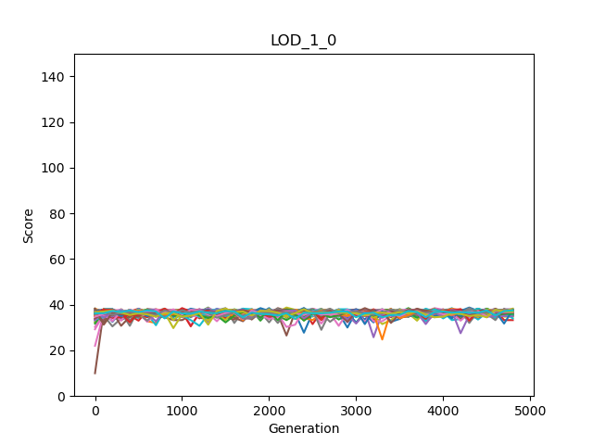
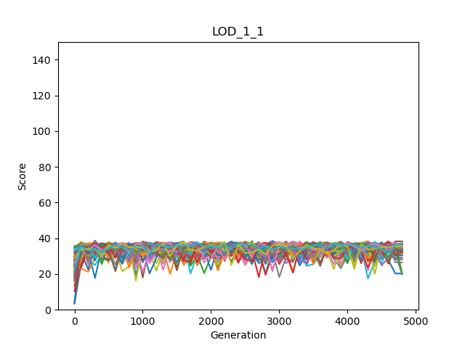
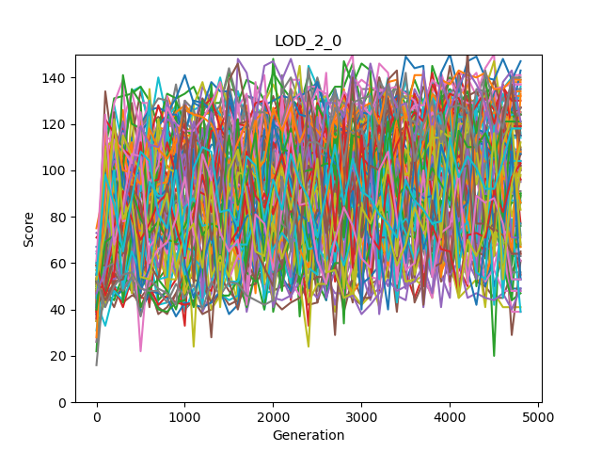
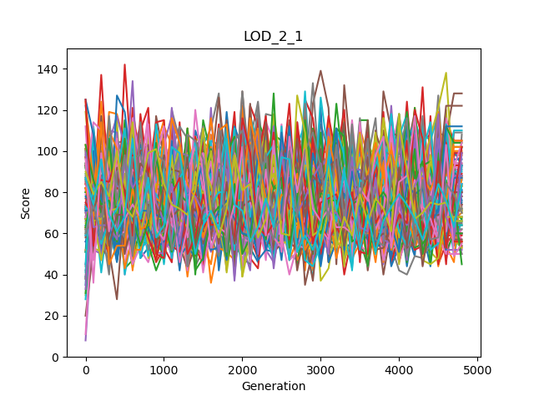
Evolution
Individual | Clone
Individual | Not Clone
Mean | Clone
Mean | Not Clone
Maximum | Clone
Maximum | Not Clone
Minimum | Clone
Minimum | Not Clone

Slide 10



So, the Marx’ dream and my ideas are both satisfied?
Performance at the end of evolution
rewardGroupModes | Mean OwnScores | Mean Minimums | Mean Maximums | Mean Averages | Mean Sums
LOD_0_0 Group mode: Clone Reward mode: Individual | 36.4275510 | 26.0175510 | 47.4516326 | 36.4275510 | 145.710204
LOD_0_1 3 Group mode: Not Clone Reward mode: Individual | 44.7497959 | 20.1351020 | 52.0906122 | 36.5244898 | 146.097959
LOD_1_0 2 Group mode: Clone Reward mode: Average | 36.4372959 | 25.8336734 | 47.5702040 | 36.4372959 | 145.749183
LOD_1_1 Group mode: Not clone Reward mode: Average | 47.0285714 | 11.6457142 | 56.7748979 | 33.9260204 | 135.704081
LOD_2_0 Group mode: Clone Reward mode: Maximum | 91.9987755 | 2.70897959 | 91.9987755 | 30.8365306 | 123.346122
LOD_2_1 Group mode: Not clone Reward mode: Maximum | 67.5675510 | 1.56244898 | 75.5930612 | 31.0185204 | 124.074081
LOD_3_0 1 Group mode: Clone Reward mode: Minimum | 30.7763265 | 30.7763265 | 42.3973469 | 36.4311734 | 145.724693
LOD_3_1 Group mode: Not clone Reward mode: Minimum | 34.1008163 | 23.0051020 | 44.5406122 | 33.0433673 | 132.173469
For Markov Brain Agents, yes!
WE
Total payoff
Minimum payoff within the group

Slide 11
a) We have identified that there is a relationship between agents' scores and their actions (beep, do nothing, and giving food to others or empty tiles). In general, communication or usage of beep causes better performance for the agents when coordination is needed
b) When we set rewarding schemes to minimum, maximum, and average, the clones perform better, whereas non-clones are better adapting under the individual reward schemes
Other points
c) The high variance in the agents' scores through the generations causes better performance at the end.

Slide 12
Using clonal agents and minimum rewarding scheme we could train a group of AI controllers (agents) to perform better individually and in teams at the same time.
Communication evolves in minimum and maximum.
Clonal groups are “less selfish”.
High variance results in better adaptation?
Different behavior strategies found.
Conclusion

Slide 13
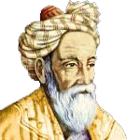
Question everything
Thank you

